Slide 1
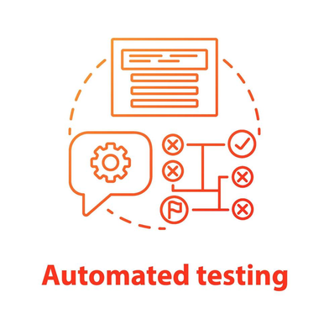

CAPSTONE PROJECT-ECOMMERCE APPLICATION TESTING
URL: https://automationexercise.com/
PRESENTED BY
PRIYANKA V
KAVIYANJALI M
ASHA R
KEERTHANA V S

Slide 2

TABLE OF CONTENTS
1.Problem Statement
2. Objective
3. Automation Tools
4. Manual testcase Demo
5. Automated Testcase Demo (Project Structure, Code snippet)
6. Sample Reports
7. Advantages of automated testing
8. Disadvantages of automated testing
9. Conclusion

Slide 3

PROBLEM STATEMENT
1. Manual testing of web applications is time-consuming, repetitive, and error-prone, which impacts efficiency and reliability.
2. Implementing a Selenium-based automation framework helps to improve test reliability, reusability, and maintainability.
3. Integration with GitHub provides proper version control and facilitates team collaboration.
4. Configuring Jenkins for Continuous Integration (CI) enables automated execution of test cases, ensuring faster feedback.
5. Incorporating reporting mechanisms ensures effective monitoring and tracking of test outcomes.

Slide 4

OBJECTIVES
To automate the UI and Functional test cases of webpage using the Selenium framework for faster and more accurate testing.
To design a robust and reusable automation framework that can handle multiple test scenarios efficiently.
To integrate GitHub for proper version control, enabling tracking of changes, collaboration, and secure storage of test scripts.
To set up Jenkins for Continuous Integration (CI) so that automated tests run automatically on each code update.
To generate detailed and easy-to-understand test reports for monitoring the status of test executions.
To minimize manual testing effort while ensuring higher reliability and consistency of test results.

Slide 5

PROPOSED AUTOMATION TOOLS
1.Selenium WebDriver: For automating web application test cases.
2. Java: Programming language for writing test scripts.
3. TestNG: Test framework for managing and executing test cases.
4. Maven: Build and dependency management tool.
5. GitHub: Version control for storing and managing automation scripts.
6. Jenkins: Continuous Integration tool to run tests automatically.
7. ExtentReports: For generating detailed test execution reports.

Slide 6
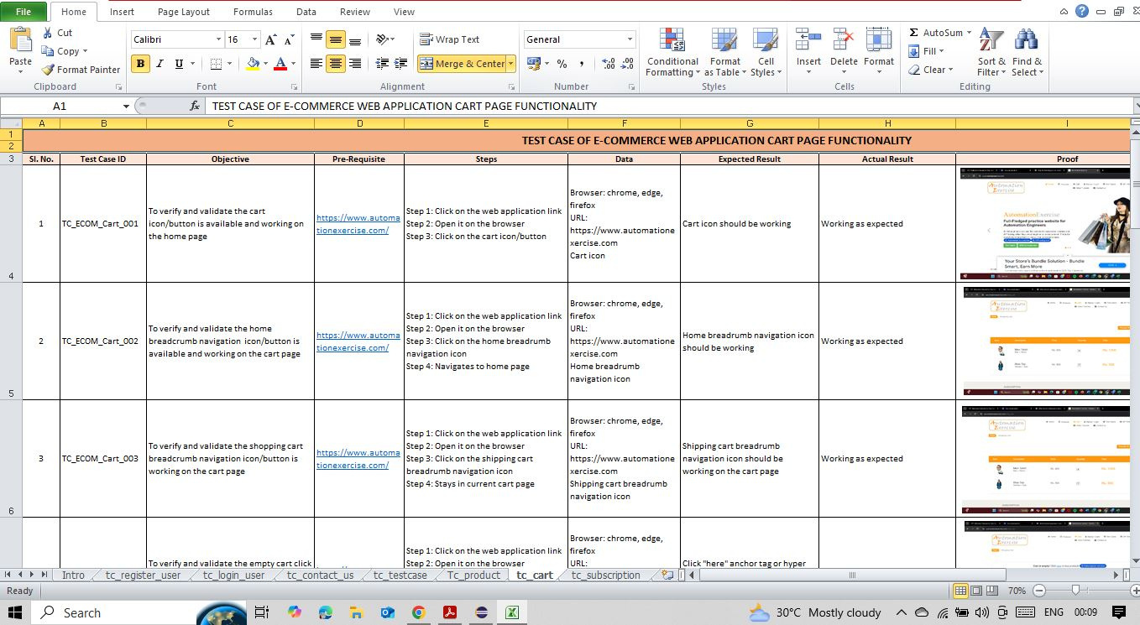
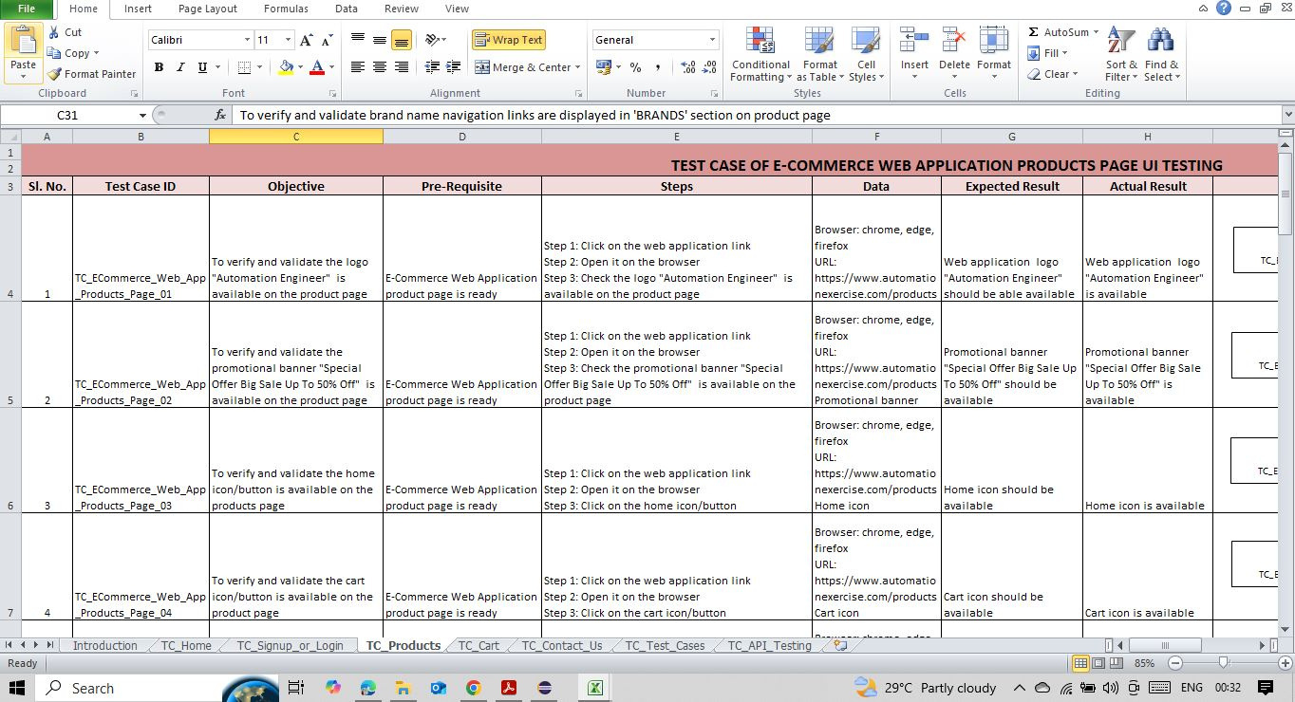

MANUAL TEST CASES
Click here to view the complete test cases

Slide 7
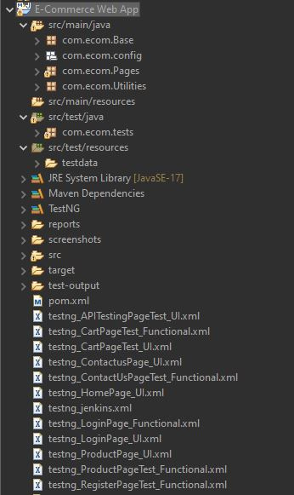
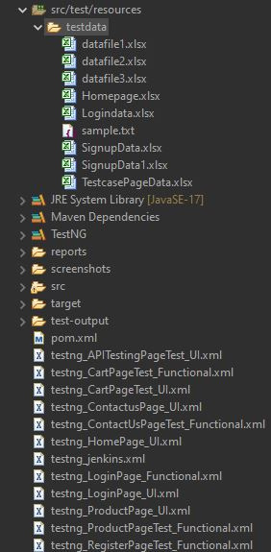
PROJECT
STRUCTURE

Slide 8
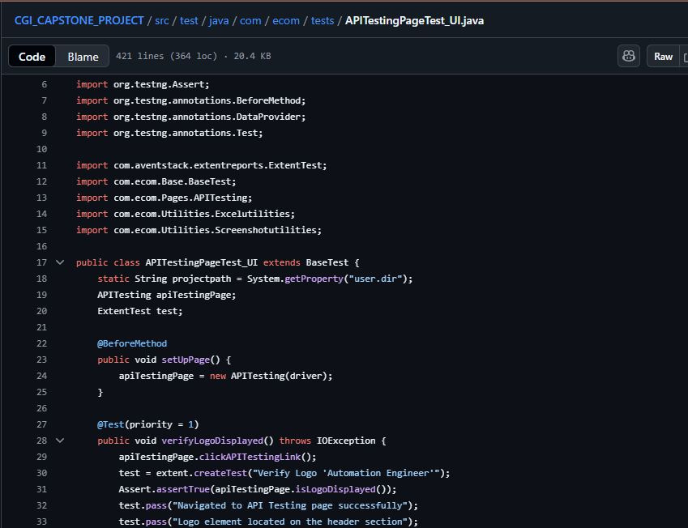
CODE SNIPPET

Slide 9
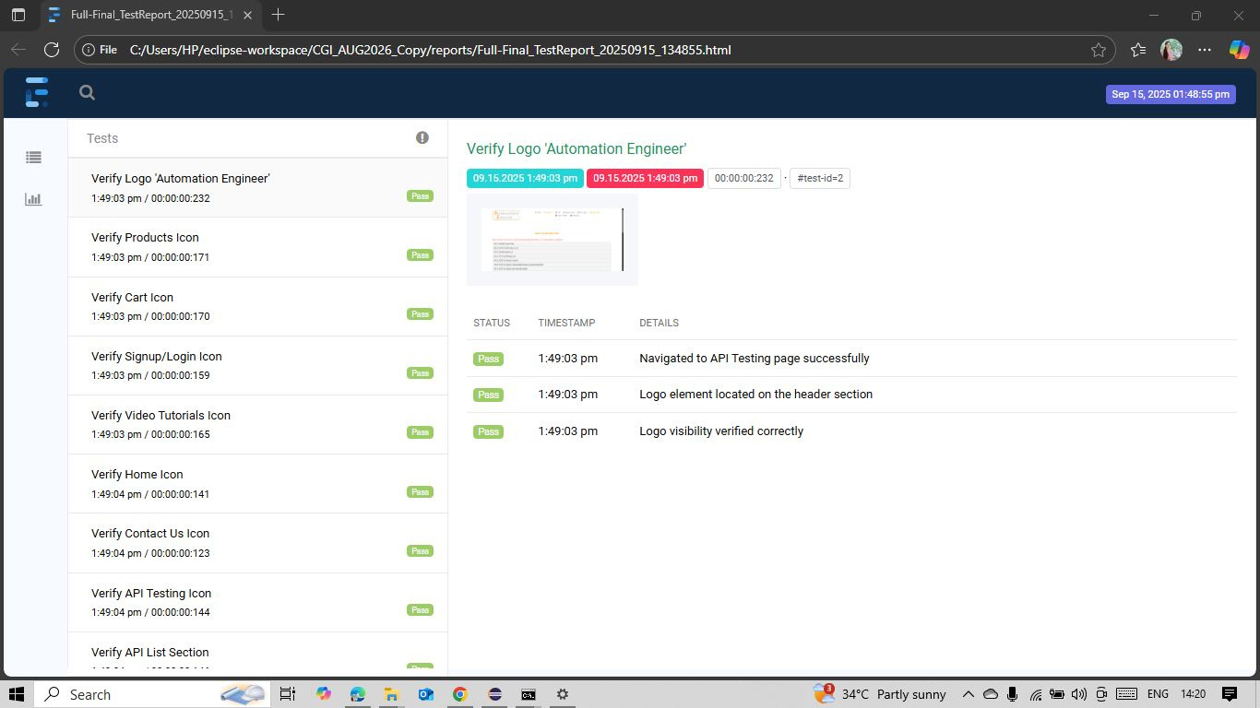
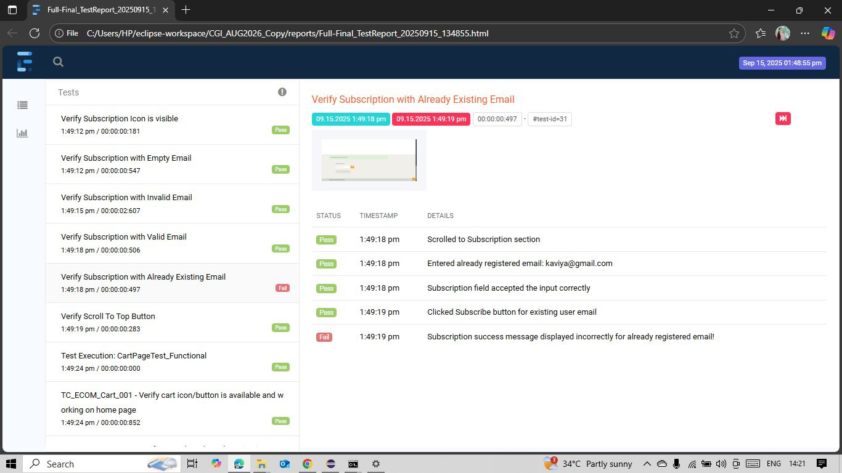
EXTENT
REPORTS

Slide 10
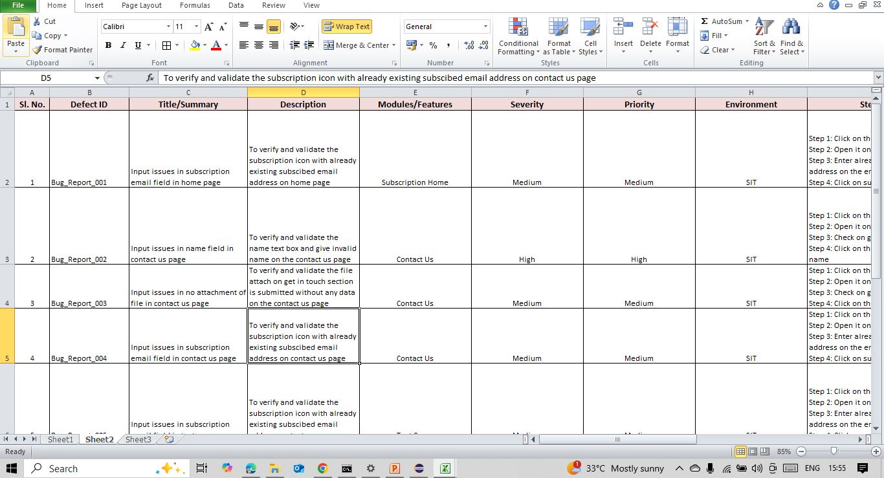
DEFECT
REPORT
Click here to view the complete report

Slide 11
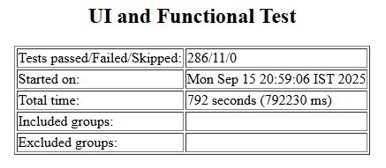
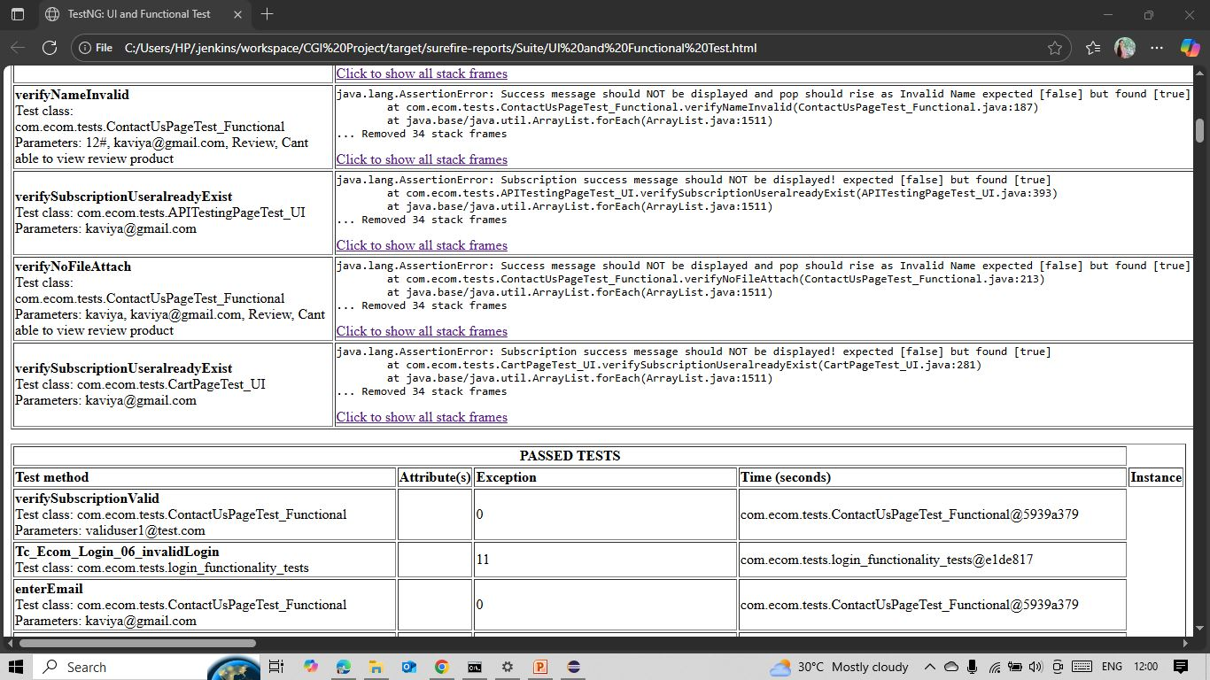
JENKINS
INTEGRATION
REPORT

Slide 12

ADVANTAGES OF AUTOMATION TESTING
Faster execution of test cases compared to manual testing
Reusable test scripts for regression and repeated runs
Improves accuracy by eliminating human errors
Enables continuous integration and delivery (CI/CD)
Provides detailed test reports and logs

Slide 13

DISADVANTAGES OF AUTOMATION TESTING
High initial setup cost and effort
Requires skilled resources to design and maintain scripts
Not suitable for exploratory or usability testing
Maintenance effort increases with frequent UI changes
Limited in testing visual aspects and user experience

Slide 14

CONCLUSION
What was the problem?
Manual testing was slow, repetitive, and error-prone.
What did we do?
Automated UI and functional test cases using Selenium, integrated with GitHub and Jenkins.
What did we achieve?
Faster, reliable, and reusable testing with continuous integration and clear reporting.
Key Takeaway:
Automation is not just about speed — it empowers us to deliver quality with confidence.

Slide 15

THANK YOU !

